Slide 1
Introduction to
the COST Framework
Ms Orsolya Tóth
Delegate of the COST Committee of Senior Officials
Budapest, 09/06/2015

Slide 2

COST Mission Statement
COST enables breakthrough scientific and technological developments leading to new concepts and products.
It thereby contributes to strengthening Europe’s research and innovation capacities.
Through trans-European networking of nationally funded research activities.
2
Notes:
On basis of this mission statement COST has submitted its proposal to recieve funding for H2020
Proposal postiveley evaluated
Set of agreements signed

Slide 3
OUTLINE
The COST Association
Agreements with the EC: FPA-SGA
COST Strategies and Policies
COST Inclusiveness Target Countries
COST Actions - how to participate?
Apply to the COST Open Call
Become a COST Expert

Slide 4
The COST Association
4

Slide 5
The COST Association
  Legal form: International non-profit Association under Belgian Law (Association International sans But Lucratif - AISBL)
  Established on 19 September 2013 by COST Member Countries, today all 36 COST Member Countries have joined
  The COST Association integrates COST governance, management and implementation functions
5
Notes:
36 COST Member Countries, including now Montenegro

Slide 6
COST Association organisation
and relation with other actors
Ministerial Conferences (every five years)
Committee Senior Officials (General Assembly)
Executive Board
Scientific Committee
COST National Coordinators
Office Services
COST Actions
6

Slide 7
Agreements with the EC:
FPA and SGAs
7

Slide 8
Agreements signed between the COST Association and the European Commission under Horizon 2020
Framework Partnership Agreement, FPA:
Duration: 7 years
Political commitment
Strategy and Policy objectives
Sets the Action Plan and secures long-term perspective
Specific Grant Agreement, SGA:
Duration: 1 year
Financial commitment
Implementation objectives
Describes the Work to be done and concrete tasks
COST at a turning point:
A unique framework for pan-European S&T cooperation
as clear demonstration of European values
Notes:
Contrary to the FP7 period when COST had a grant agreement for the total duration of FP7 with obligatory annual amendments,
For H2020 the COST Association has secured its funding via a 2 level sets of agreements
The main characteristics of the agreements are shown on this slide
In the following slides the CNC related points will be highlighted. First the FPA

Slide 9
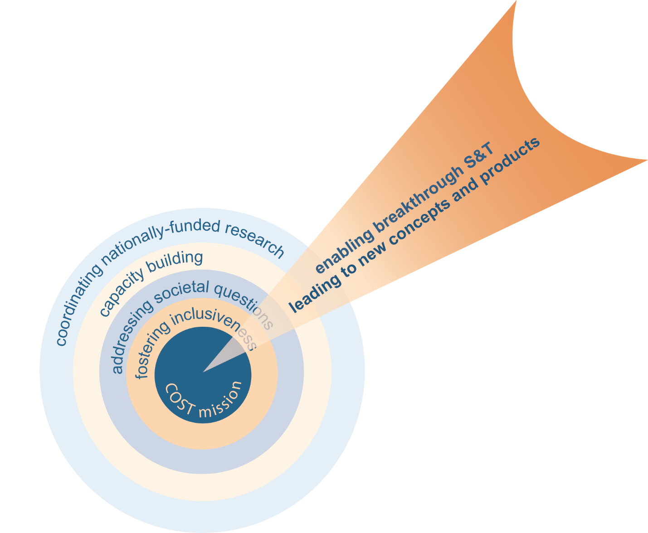
COST Budget and Objectives
EUR 300 million budget (constant prices) for 7 years drawn from two Horizon 2020 work programmes:
    Challenge 6 “Europe in a changing world – inclusive, innovative and reflective Societies”
    “Spreading Excellence and Widening Participation”
    Four specific Objectives to fulfil COST mission:
Joining research efforts and developing common S&T programmes
Building capacity
Addressing societal questions
Strengthening COST’s Inclusiveness Policy

Slide 10

To achieve these Objectives
COST Key Principles
Supporting excellence
Being open
Being inclusive
COST Driving Forces
Fostering new ideas
Sharing knowledge
Output orientation
10
Notes:
Basic concept of the proposal was to clearly define the key principles and driving forces
40 years
Bottom-Up
All Disciplines
High Quality
Networking of Excellence
Young
Enabling Early Career Researchers
Experienced
Networking scientists across all generations
Inclusive
Intergovernmental – Pan-European – All Participants (Public, NGOs, Private RTO, Industry, SMEs etc)
A la Carte
Researchers at any stage in their careers
Open
Global Cooperation – Near Neighbours

Slide 11
Actions running on 24/2/2015: 306
COST Action participation
Notes:
Montenegro is not included on the list as it is just a new member. FYI Montenegro is currently participating in 14 COST Actions

Slide 12
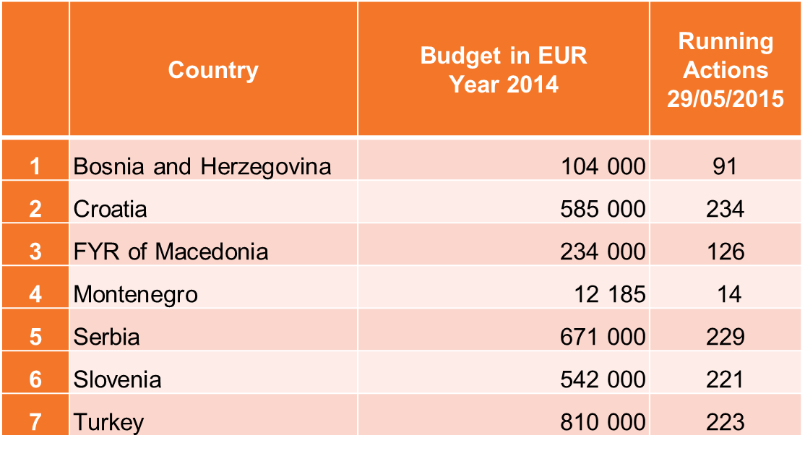
COST Action participation

Slide 13
Number of researchers in COST Actions
Notes:
Montenegro is not included. ME joined the COST Association as a Full member on the 194th C SO meeting which took place on 12-13 May 2015. ME participates today in 14 COST Actions.

Slide 14
COST Strategies and Policies
11

Slide 15
Strengthen Strategies and Policies
Excellence and Inclusiveness Policy
  Geographical, age, gender
Impact Orientation
  Impact assessment
Industrial Dimension
  SMEs
International Cooperation
  Near Neighbour Countries, NNC
Strategic Initiatives
  Targeted Networks
Communication Strategy
  Outreach and Conferences
http://www.cost.eu/about_cost/strategy
12
Notes:
Basic concept of the proposal was to clearly define the key principles and driving forces
40 years
Bottom-Up
All Disciplines
High Quality
Networking of Excellence
Young
Enabling Early Career Researchers
Experienced
Networking scientists across all generations
Inclusive
Intergovernmental – Pan-European – All Participants (Public, NGOs, Private RTO, Industry, SMEs etc)
A la Carte
Researchers at any stage in their careers
Open
Global Cooperation – Near Neighbours

Slide 16
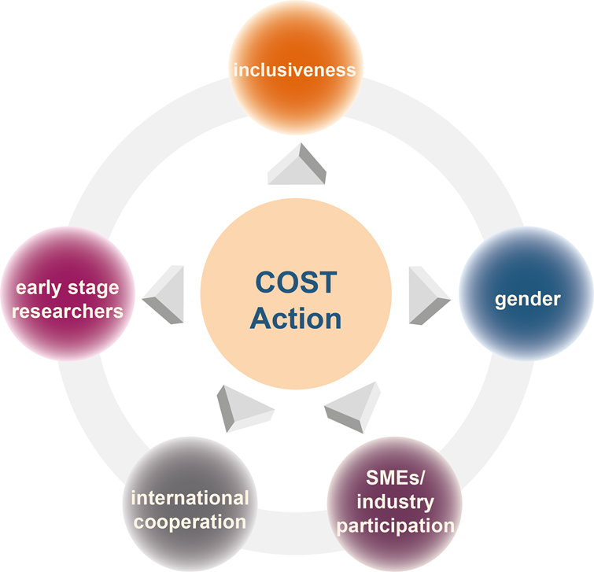
Aiming at
  Excellence &
  Inclusiveness
  Geographical
  Early stage researchers (ESRs)
  Gender balance
  Openess
  All fields of S&T
  SMEs/industry participation
  All countries
Notes:
Policy refers to a course or principle of action adopted or proposed by an organization or individual” online Oxford dictionary http://www.oxforddictionaries.com/definition/english/policy.

Slide 17
Excellence and Inclusiveness
Encouraging and enabling excellent researchers from less research-intensive countries across Europe to set up, lead or join COST Actions
Counterbalancing research communities’ unequal access to knowledge infrastructures, funding and resources distribution
Contributing to the realization of Horizon 2020 Widening Pillar objectives trough COST Excellence and Inclusiveness Policy

Slide 18
COST Inclusiveness Target Countries
COST Member Countries
EU Member States | Associated Countries to Horizon 2020
Bulgaria, Cyprus, Czech Republic, Estonia, Croatia, Hungary, Lithuania, Latvia, Luxembourg, Malta, Poland, Portugal, Romania, Slovenia, Slovakia | the former Yugoslav Republic of Macedonia, Montenegro, Republic of Serbia, Turkey Bosnia-Herzegovina

Slide 19

Early Stage Researchers
PhD* ≤ 8 years
Address the difficulty in gaining visibility and recognition European-wide
Entrusting young investigators with leader roles under their own responsibility
COST Inclusiveness
Policy supports
ESRs
*PhD or equivalent experience

Slide 20

Gender Balance
male/female
  Encourage and enable under-represented gender to be intensively involved in all COST activities
  Networking the way to gender equality in science and technology
COST Inclusiveness
Policy supports
Gender balance

Slide 21
Specific inclusiveness-oriented activities
Seeking researchers’ full involvement by taking up:
  Initiator roles in preparing proposals for COST Actions
  Partner roles in Action proposals
  Leadership roles in COST Actions
  Grant Holder role
Seeking Inclusiveness Target Countries’ full involvement by organising:
  COST Info Days
  Strategic inititiaves
  Conferences
  Workshops
Raising awareness at various events

Slide 22
Targeted Networks serving COST Policies
The objective is to use the COST networking instrument for targeting specific policy priorities in order to:
Strengthen the role of COST in its policy priorities
Stimulate the strategic development of future oriented societal questions
Contribute to EU2020 political goals
TN1401 Capacity Building in Forest Policy and Governance in Western Balkan Region – CAPABAL
  enhance the forest and natural resources governance, policy, and economics capacity in the Western Balkan region
  Future policy-makers in Western Balkan region
  Researchers in relevant areas (capacity building)

Slide 23
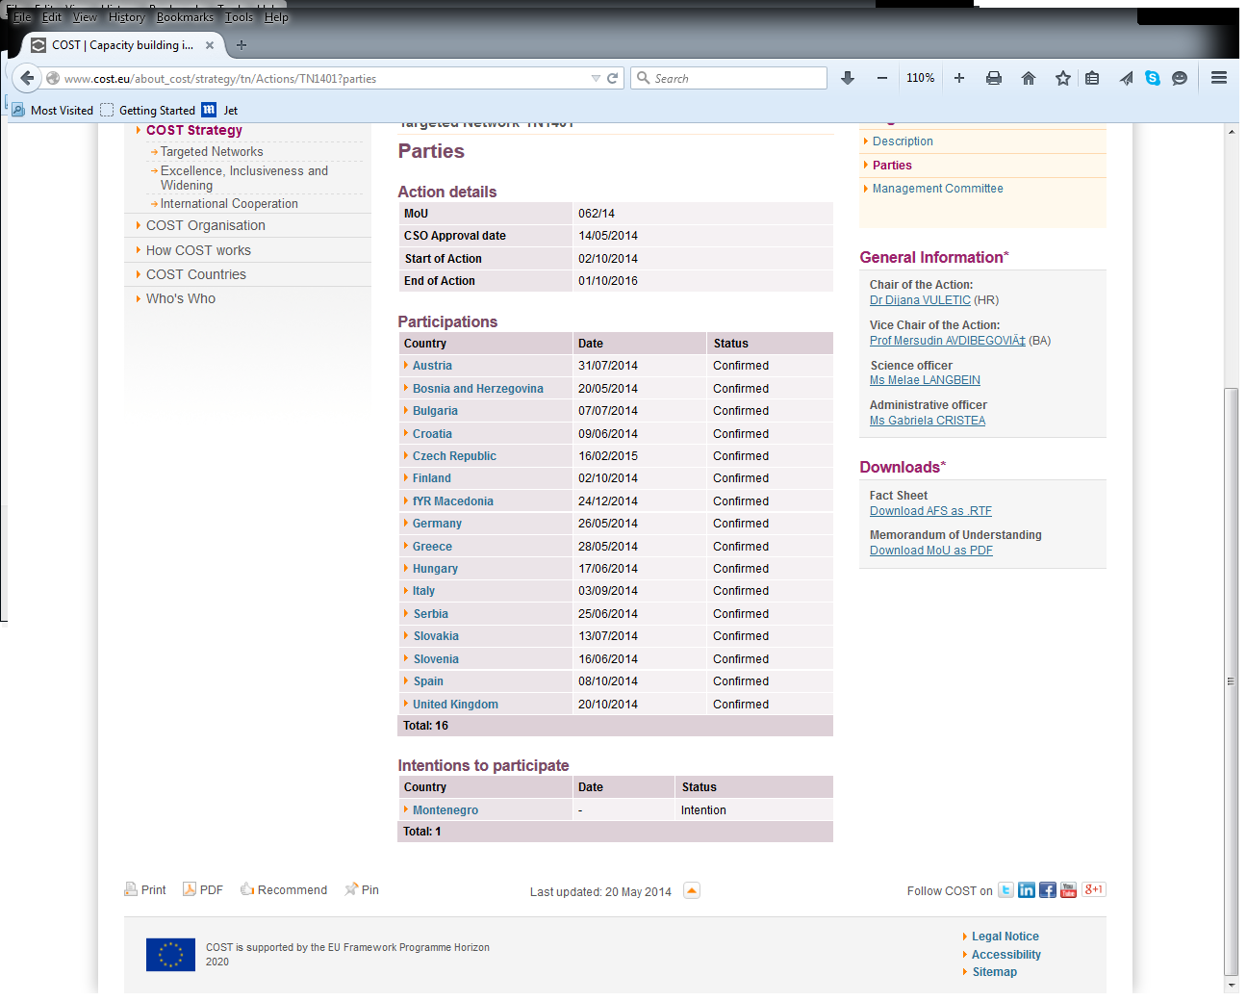
TN 1401 Capacity Building in Forest Policy and Governance in Western Balkan Region – CAPABAL
To enhance forest and natural resources governance, policy, and sustainable multifunctional forest management in the Western Balkan region and Europe in general by creating a strong, regional collaborative network of experienced and future leaders in science, policy, and management well connected to European and international networks

Slide 24
TN 1401 Secondary objective
Consolidate a regional network of ESRs in forest and natural resources governance, policy, and economics in the Western Balkan region and enhance their capacity by linking them to leading researchers in these fields in Europe.
Create new networks of future leaders in policy and practice – forest and natural resources management –and link them to existing policy leaders and experts in sustainable multifunctional forest management in Europe.
Build a strong, collaborative network of future leaders in science, policy, and practice that is closely linked to existing networks in these areas so as to increase their capacity to develop high quality policy relevant research, new policy instruments, and new approaches to SFM.
Develop regional Vision document and Strategic Research Agenda addressing challenges and opportunities identified in the Vision document.
Develop strong linkages with other relevant policy focused networks and processes in forest and natural resources governance, policy, and economics at the pan-European level to improve sustainable forest and natural resources management and governance in the region.
Secure the sustainability of the newly developed capacities by strengthening its engagement with European researchers, enabling better external funding and bringing change to national research funding priorities including forest and natural resources governance and policy as high priority topics.

Slide 25
TN 1401 Partners
  Chair: Dijana Vuletic (HR)
  Vice Chair: Mersudin Avdibegović (BA)
  Grant Holder: Croatian Forest Research Institute

Slide 26
COST ACTIONS

Slide 27
COST Actions are Networks
Pan-European, bottom-up science and technology networks open to researchers, industry and policy stakeholders
Duration up to 4 years
Minimum of 5 COST Member Countries
Through different networking tools:
Meetings (MC, WG), Short-term Scientific Missions, Training schools, Publications & dissemination activities

Slide 28
COST Actions are Open
  All fields of S&T (including interdisciplinary, new and emergent fields)
  Any novel and original idea (innovative)
  All partners (public and private, big and small)
  All career stages (young and senior investigators)
  All countries (including COST Near Neighbour Countries and International Partner Countries)

Slide 29
COST Actions – 2014
330 running COST Actions
30 000 Participants
2370 STSMs
> 1300 Scientific workshops and meetings
> 220 Training schools
> 5000 Training school participants

Slide 30
Do you want to participate?
http://www.cost.eu/participate

Slide 31
Who can participate?
Researchers, engineers and scholars from:
  COST Member Countries and
  Cooperating State
  Near Neighbour Countries
  International Partner Countries
  European Commission and EU Agencies
  European RTD Organisations
  International Organisations

Slide 32
Would you like to join an existing COST Action?
http://www.cost.eu/participate/join_action

Slide 33
COST Actions are Open!
You can join any Action that is running:
as a MC Member:
  By contacting your CNC in order to be one (of the maximum two) MC members representing your Country
as a WG Participant:
  By contacting you respective MC member and or the Action Chair and participate in the Working Groups

Slide 34
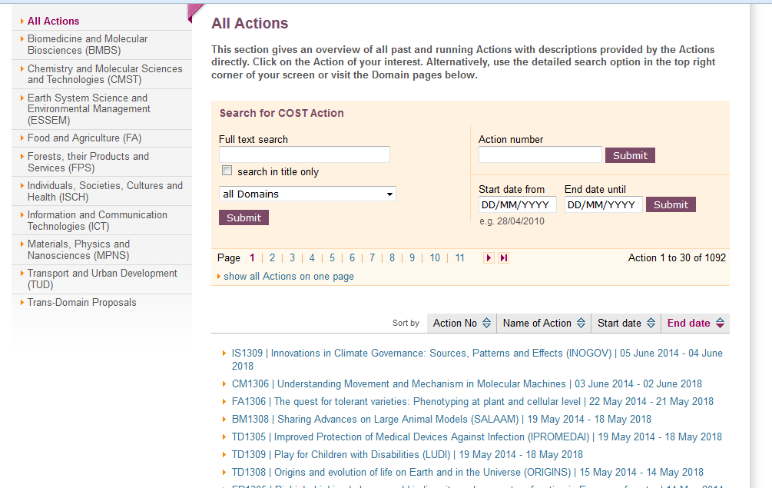
How to find a running Action?
  http://www.cost.eu/domains_actions/all_actions

Slide 35
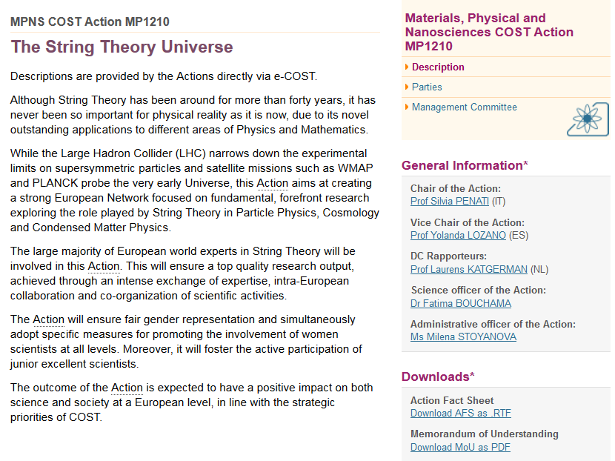
How to find a running Action?
Description of the Action Objectives, Working Groups, etc…

Slide 36
Would like to submit a COST Action proposal?
http://www.cost.eu/participate/open_call

Slide 37

Make your own COST proposal
What do you need?
An idea on any Science and Technology topic that needs networking support
At least 5 colleagues from 5 different COST Member Countries (or Cooperating State)

Slide 38
New Action Proposal Evaluation and Selection Procedure
  The new COST scientific organisation:
  One-stage submission
    Proposal up to 15 pages
  Three-step procedure
    Evaluation (External Experts)
    Revision (Review Panels)
    Selection (Scientific Committee)

Slide 39
Action Proposal Evaluation
    Driven by renowned international external experts (peer review)
    Based on excellence, impact and implementation criteria
    Each proposal anonymously and remotely evaluated by three independent External Experts in the science and technology field(s) indicated by the proposers
    Consensus-oriented, using on-line collaborative tools
Notes:
Peer review is based on the scientific field and subfield that the proposer has identified for his/her proposal, evaluators will be allocated to the proposal based on this information

Slide 40
Action Proposal Revision
    Driven by ad hoc Review Panels created according to the actual needs of the proposals submitted to each Collection Date
    Review Panels composed of active scientists nominated by the COST National Coordinators to a pool of experts
    Review Panels reporting to the Scientific Committee, quality checks and resolution of eventual discrepancies

Slide 41
Action Proposal Selection
    The Scientific Committee, appointed by and reporting to the CSO
    High-level experts, one per COST Member Country
    The Scientific Committee selects the top-ranked proposals to be recommended for approval by the CSO

Slide 42
COST Open Call
The new Open Call is published on the COST website
Proposals can be submitted at any moment
Collection Date Septmber 2015 (exact date to be announced soon)
Stay tuned for COST updates: www.cost.eu/opencall

Slide 43
Become a COST Expert
http://www.cost.eu/participate/experts

Slide 44
Become a COST Expert!
As a COST Expert, you will have the opportunity to:
Contribute to the evaluation of COST Open Call proposals
Participate in the assessment of Action results and outcomes
Be invited to take part in the assessment of COST strategic activities
New experts can express their interest via the COST Expert online registration form: www.cost.eu/experts
An updated Curriculum Vitae with a list of publications is required to demonstrate competence in specific areas of expertise.
More on COST Experts: www.cost.eu/participate/experts

Slide 45


Thank you for your attention!
COST Association
Avenue Louise 149
1050 Brussels, Belgium
T: +32 (0)2 533 3810
F: +32 (0)2 533 3890
office@cost.eu
Get COST News by e-mail
by signing up at
www.cost.eu/notification
www.facebook.com/COST.Programme
twitter.com/COSTprogramme
www.cost.eu
www.linkedin.com/groups?gid=1699127

