Slide 1
Why you need to have a NREN
Dirk Haex – Technical Director
23 September 2019

Slide 2
Setting the scene
Some history - Key milestones

Slide 3
When and how did it all start?
11322
days ago

Slide 4

Belnet, part of Belgian Science Policy

Slide 5
Belnet in the early days
In 1993:
  3 employees
  27 institutions
  a network infrastructure (64 kbit/s)
Around the turn of the century (“Y2K”):
  12 employees
  95 institutions
  Still a network infrastructure (622 Mbit/s (ATM))

Slide 6
Belnet in the early days
EUROPANET
2 Mbps
Antwerpen
Mol
Gent
Hasselt
Kortrijk
Leuven
Brussels
Science
LLN
Liège
Mons
Namur
EBONE
Local loop 64 kbps
64 kbps
256 kbps
Arlon

Slide 7

As from early 2000: start of a new era
E-government infrastructure in Belgium

Slide 8








As from early 2000: start of a new era
Infrastructure and connectivity is not enough: give us…
Support & Advice
Quality & Reliability
Added Value Services,
stable and secure
24 x 7
Customer oriented
approach
Trusted Partner
A neutral & stable
Service provider

Slide 9
The role of Belnet today
26 years later…

Slide 10
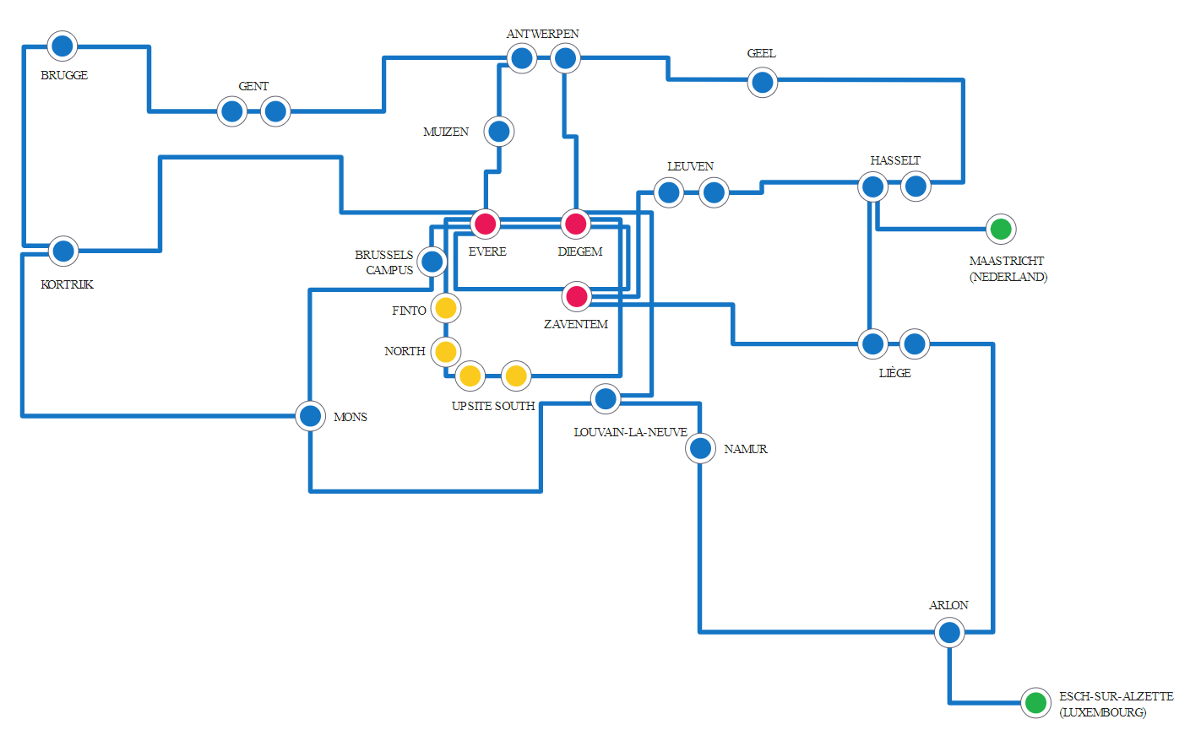

Slide 11
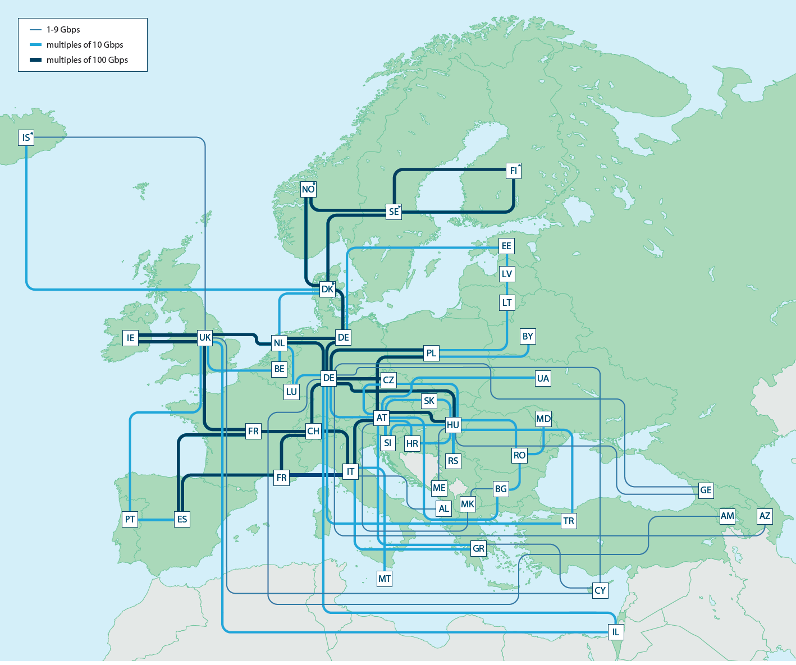

Slide 12


“NRENs consolidate the power of networking, both from the technical and community perspectives”

Slide 13
International collaboration
SIG-ISM
TF-CSIRT
REFEDS
CLAW
SIG-Multimedia
SIG-NOC
SIG-CISS
TF-RED
SIG-MSP
SIG-MARCOMS

Slide 14
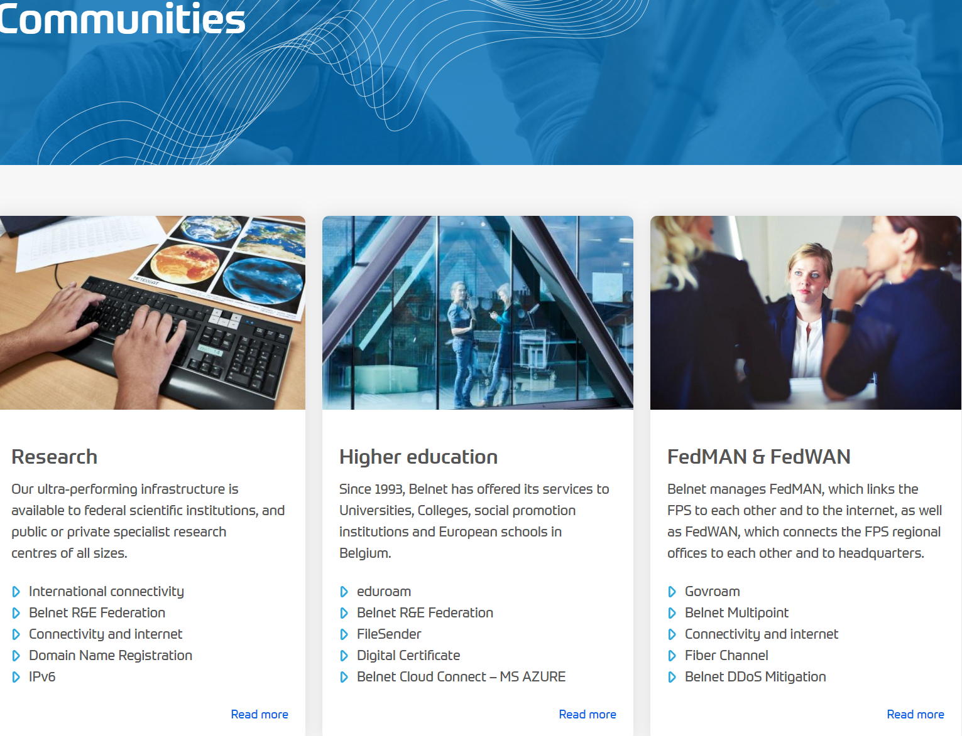


Slide 15
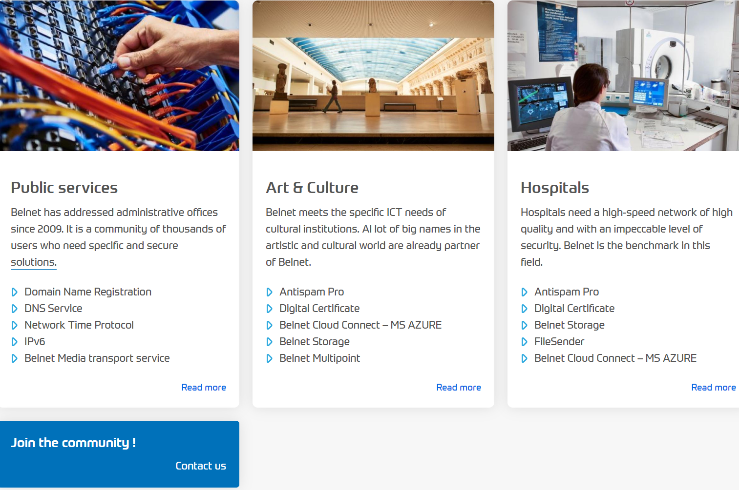

Slide 16
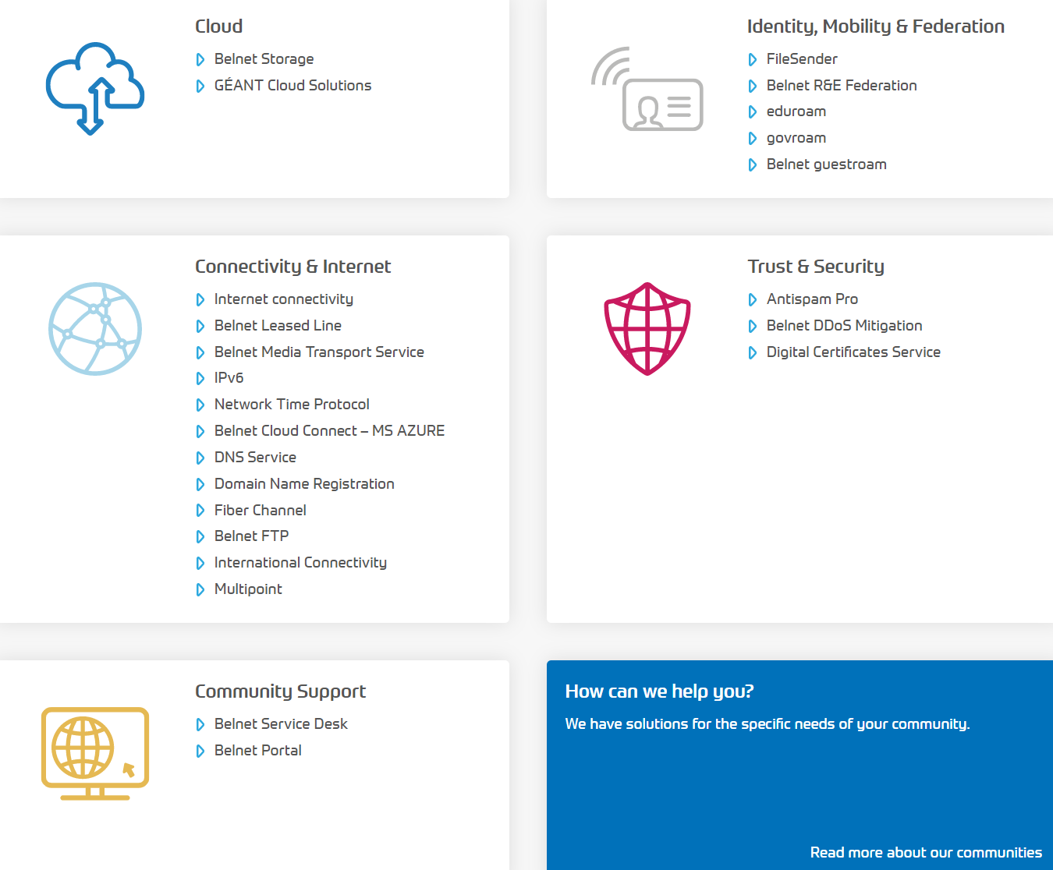

Slide 17
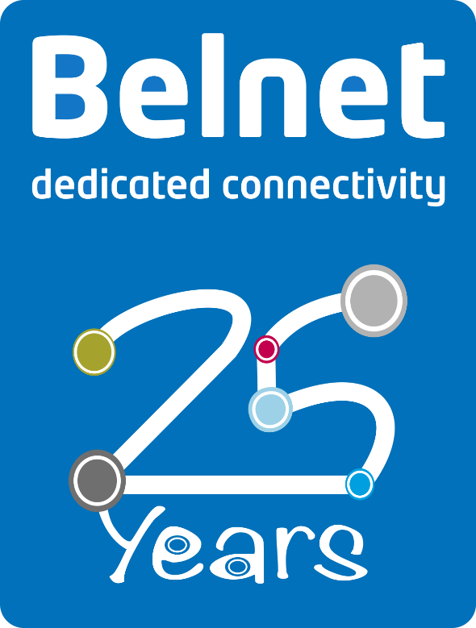

Slide 18
The future role of Belnet

Slide 19
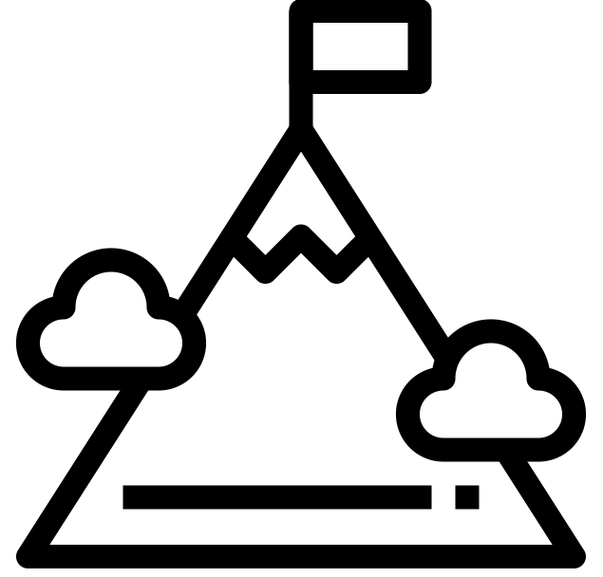
Our strategic objectives
Operational Excellence
Dedicated Services
Information Security
Performing Organisation

Slide 20
European Open Science Cloud (EOSC)
Belnets commitment as from 2020
  Focus on operational side, not on Open Data/Open Science Policy
  Foster uptake of EOSC as NREN
    Promote, inform and guide users & data & service providers
  Support and co-develop added-value applications and services
    To help users to interact and collaborate over the (inter)national research network(s)
In close collaboration with our partners, amongst others:
  Geant and the Belgian Federal Science Policy Office
  Regional governments & research partners

Slide 21

European Open Science Cloud (EOSC)
Ultimate goal:
NREN as national hub and access point for EOSC infrastructures, applications & services

Slide 22
Conclusions
Belnet as an NREN:
  Key e-infrastructure for Research, Education and innovation
  Part of the Geant ecosystem, strong focus on collaboration
  Focus on specific needs from the R&E community
  Key e-infrastructure for the digital government in Belgium

Slide 23
References
https://www.belnet.be
https://www.belspo.be
Digital Government in Belgium
  https://joinup.ec.europa.eu/collection/nifo-national-interoperability-framework-observatory/digital-government-factsheets-2018
  https://gcloud.belgium.be

Slide 24
Thank you
for your attention

