Slide 1

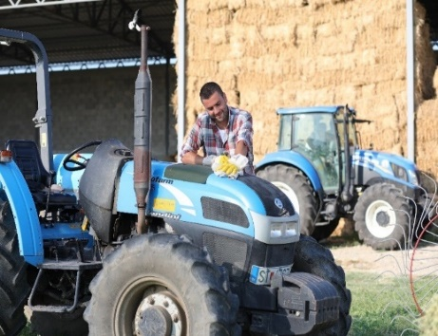
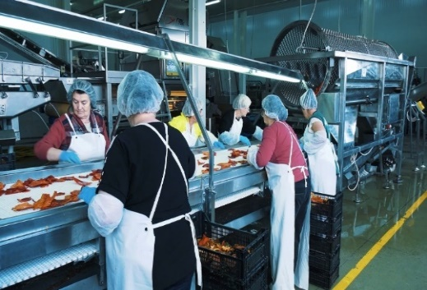
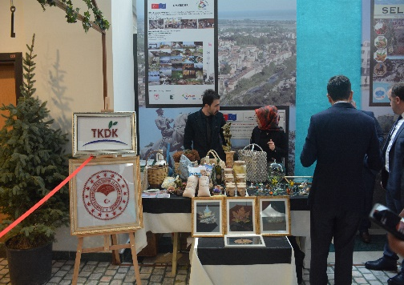
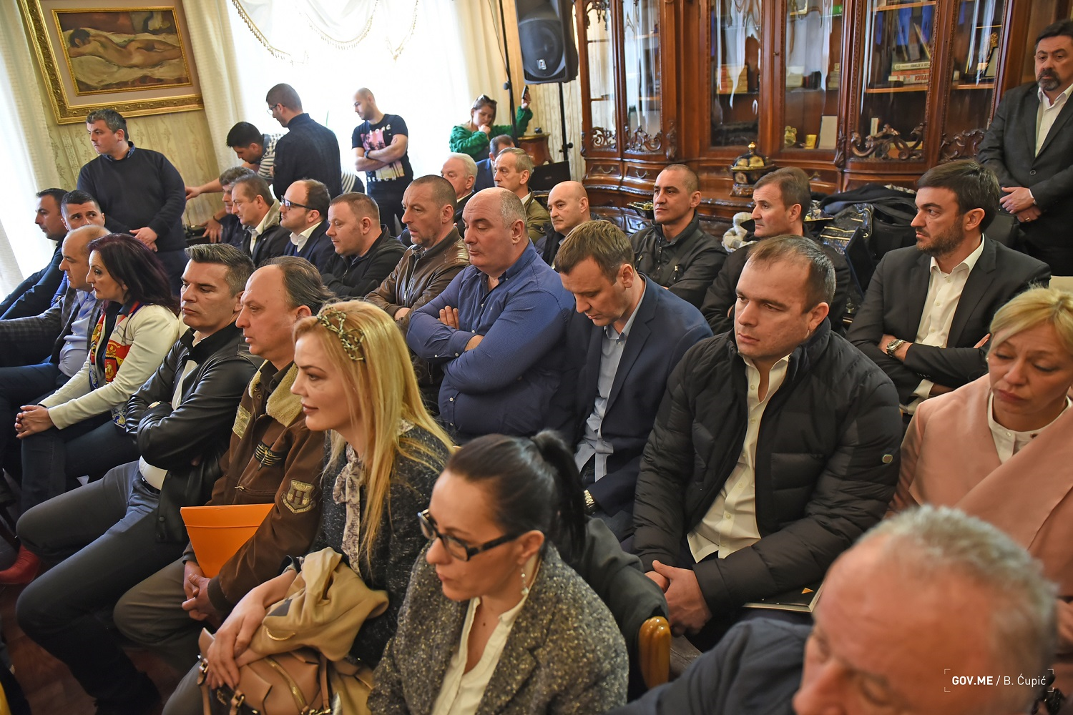
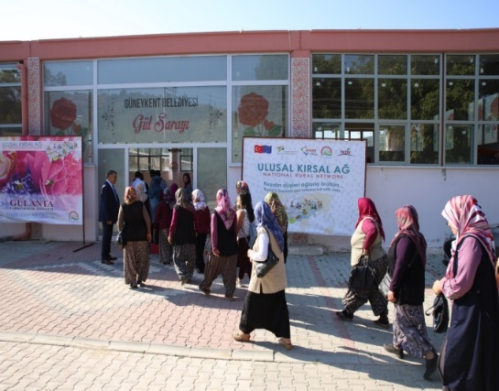
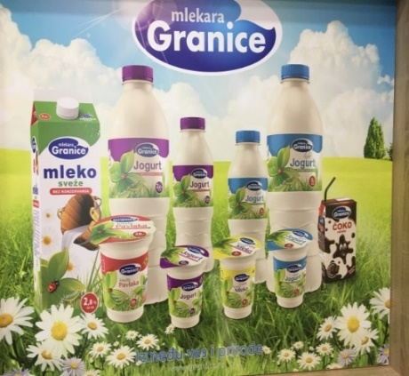
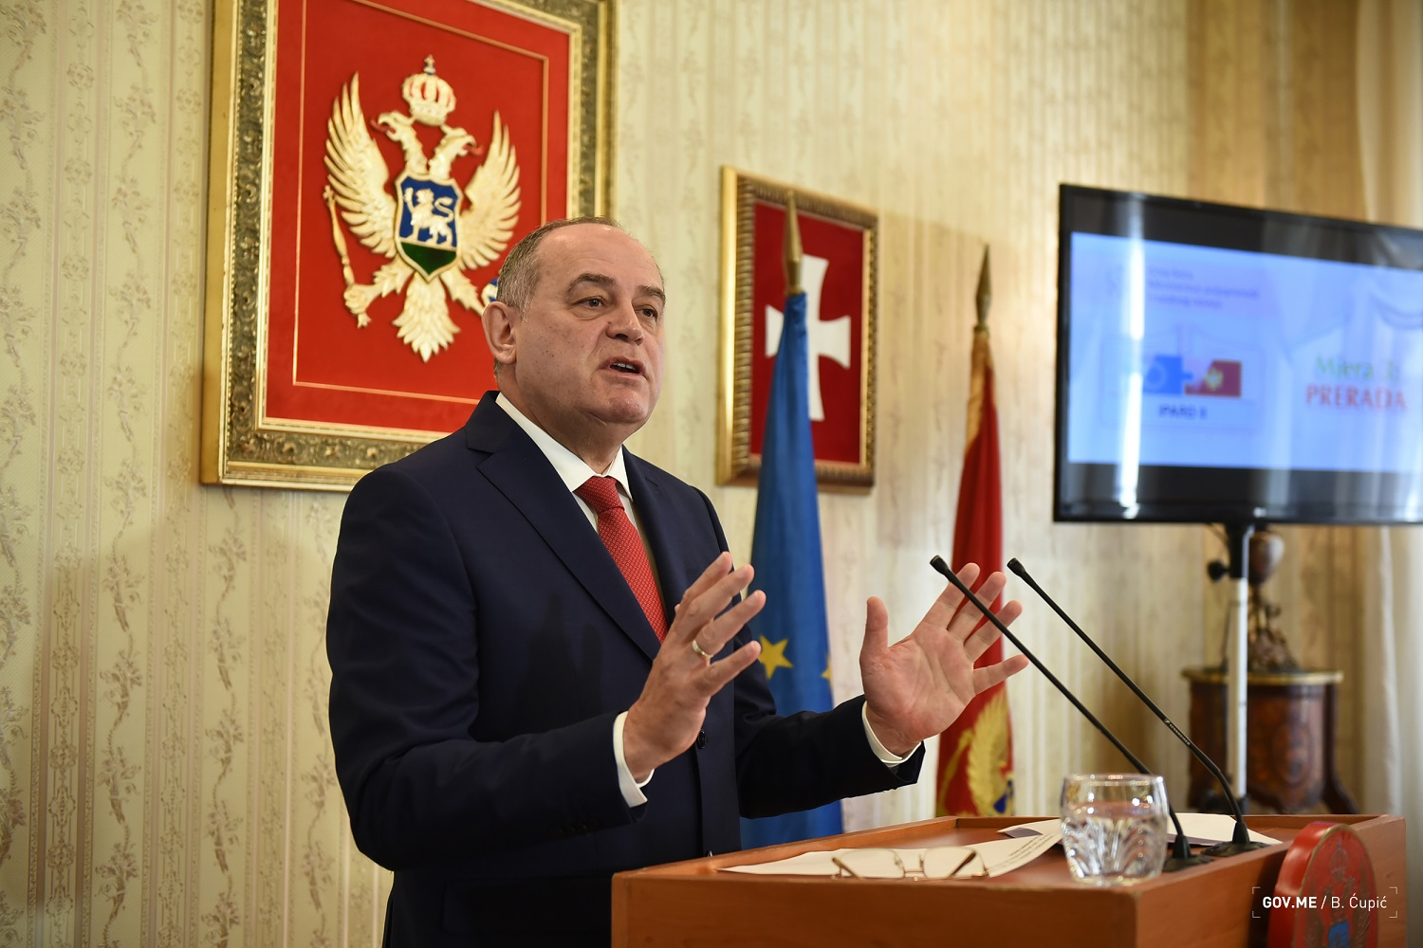
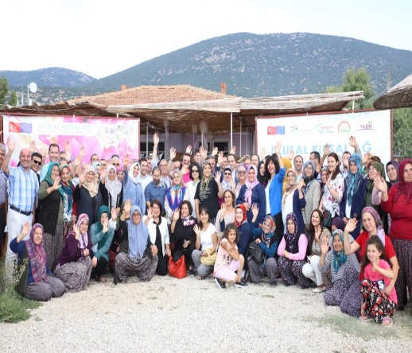
Research and innovation in IPARD?
Pre-accession assistance to rural development in the Western Balkans and Turkey

Slide 2

With whom are we working?
Albania, Montenegro, North Macedonia, Serbia, Turkey
Kosovo, Bosnia & Herzegovina
DG AGRI Auditors
DG AGRI enlargement unit and lawyers
DG AGRI rural development
EU Delegations
DG NEAR

Slide 3
Funds and most commonly used measures
Albania | Montenegro | N. Maced. | Serbia | Turkey | Total
70 | 39 | 68 | 175 | ~615 | <1 billion
Investments in physical assets of agricultural holdings
Investments in processing and marketing of agricultural products
Leader
Farm diversification and business development
Technical assistance

Slide 4

Why are we providing IPARD assistance?
Preparation for CAP long term
Support to enlargement, transformation of agricultural and primary processing sector
Boost for trade
Better food standards, competitiveness and living conditions in Europe and nearby
Promotion of EU democratic and governance standards
Security and stability in Europe and nearby

Slide 5

IPARD programme cycle
Programming
(IPARD Managing Authority + EU Commission)
Institution building + entrustment per measure
(IPARD Agency)
Launch of calls for projects
Information to potential recipients
Project applications by recipients
Contracting
From 2019 to 2023
Project implementation by recipients
Payments
Visible physical results emerge: investments in place
From 2018
2013 - 2018
2013-2014

Slide 6
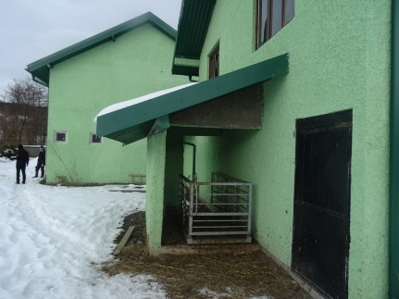
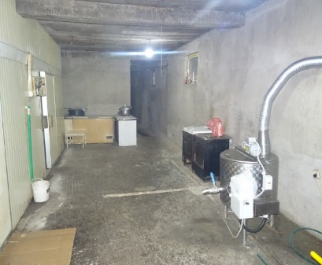
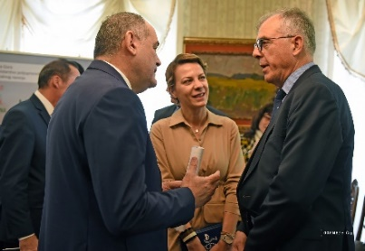
A “new” IPARD programme (Montenegro)
Example:
Transfer of funding – investments in rural development
Institution building and governance
Wider political context
Montenegro amongst most advanced in accession process
IPARD visible in prime time media and top level politicians
Paying Agency and Managing Authority small, but well cooperating
EU contribution is 39 million EUR for 2015-2020.
Target: 830 projects – none completed
121 projects contracted

Slide 7
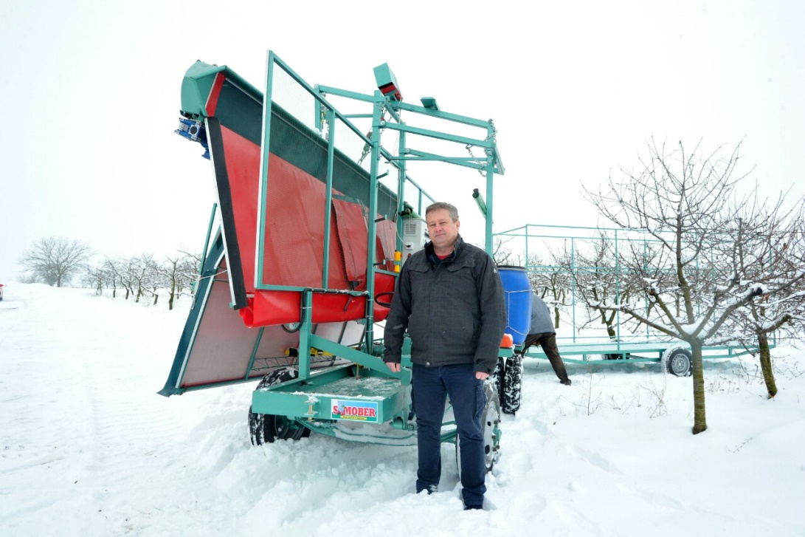
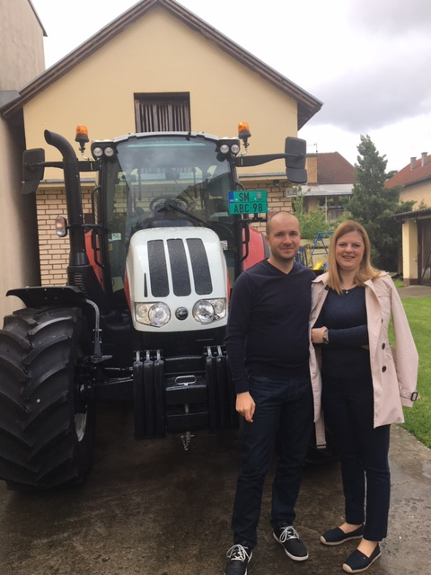
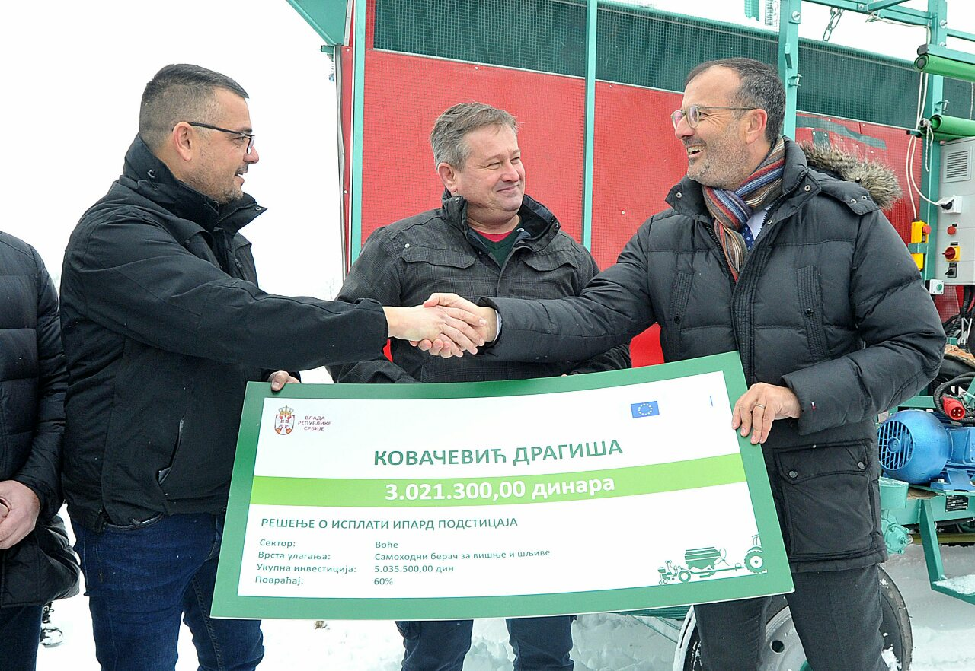

Slide 8
An “older” IPARD programme with longer experience (Turkey)
Example:
Transfer of funding, but also innovation/know-how
12 000 projects completed; 2 000 projects on-going; 57 000 jobs created (since 2007)
Institution building and governance
IPARD Agency has 2 000 staff and covers half of Turkey
Wider political context
An outstanding example of EU cooperation with Turkey but still subject to the overall political context
Is a quality benchmark in Turkey and several Asian countries
Fundamental change of mentality from ad-hoc intervention to more transparent, fact-based policy making – more interest in real rural development
Budget 801 million indicative for 2014-2020, recently cut

Slide 9
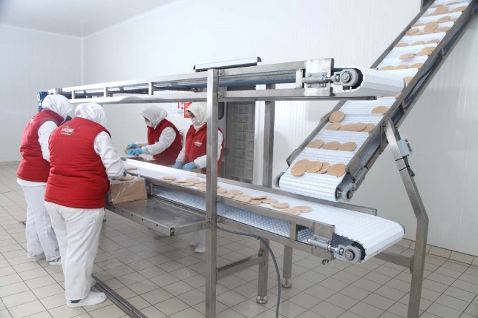
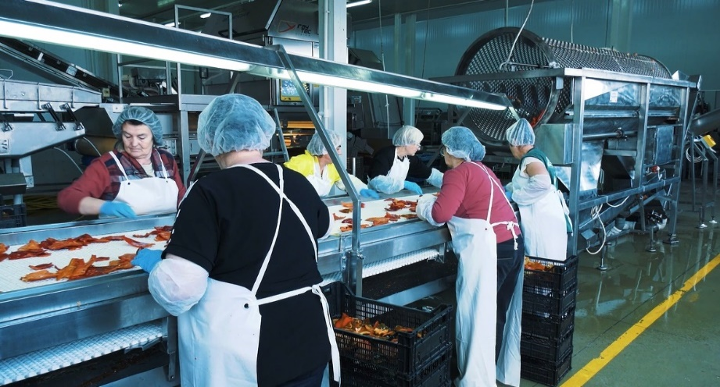
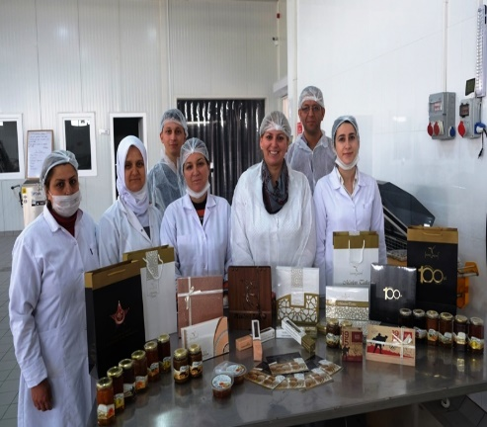

Slide 10
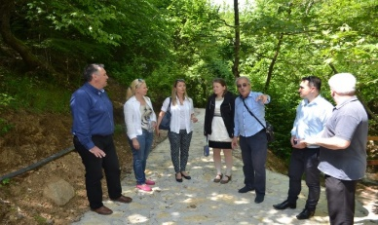
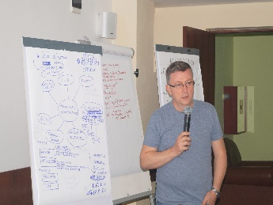
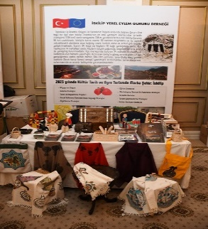
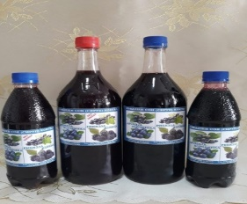
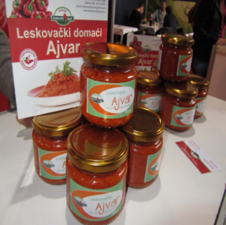
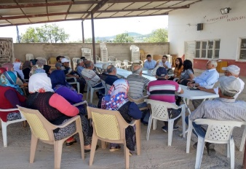
Research and innovation: context
  Low level of technological development
  Relatively large funds available to upgrade technologies
  Need for new knowledge
  Both in production and processing
  Researchers
  Lack of funding and research infrastructure
  Extension and advisory services
  Private consultancy
TECHNOLOGICAL DEVELOPMENT
WEAK RESEARCH CAPACITIES
WEAK KNOWLEDGE TRANSFER

Slide 11
Research and innovation: needs
  Bring new technologies to the region
  Bring know-how to the region
  Inventory of research capacities - AGRI
  Strengthen research infrastructure
  Improve advisory services
  Work with the private sector – combine IPARD funds with knowledge and technology transfer
TECHNOLOGICAL DEVELOPMENT
WEAK RESEARCH CAPACITIES
WEAK KNOWLEDGE TRANSFER

